Slide 1
Enhancing E-learning Platforms with Learning Speed Classification Using XGBoost
For Learners
A presentation by Group 14 Computer Science

Slide 2
Participants
21/0881 Ogbechie Chukwufumnaya Anthonia
21/0669 Ayofe Faheez Adekola
21/2666 Okafor Stephanie Ifechukwu

Slide 3
Table of contents
01.
02.
03.
04.
05.
06.
Abstract
Introduction
Statement of problem
Aim and Objectives
Literature Review
Modeling and Design
07.
08.
Methodology
Results

Slide 4
Table of contents
09.
10.
11.
12.
Conculsion
Recommendations
References
Appreciation

Slide 5
01.
Abstract

Slide 6

Abstract
E-learning platforms use a uniform learning approach, ignoring differences in student learning speeds.This study introduces an AI-driven system using XGBoost to classify students as fast, medium, or slow learners based on their quiz performance, time spent on lessons, and engagement.The classification allows personalized learning experiences that improve engagement and academic performance.Results show that adaptive learning enhances retention, motivation, and efficiency in e-learning.

Slide 7
02.
Introduction

Slide 8
Introduction
E-learning platforms have become part of modern education, offering flexibility for students to learn anywhere. However, most platforms use a uniform approach that does not adjust for different learning paces.
This affects students’ motivation and performance.

Slide 9
03.
Statement of Problem

Slide 10
Problem Statement
Existing e-learning systems lack personalized learning modifications, leading to decreased engagement and performance.
This study addresses the need for learning speed classification to customize content delivery.

Slide 11
04.
Aims and Objectives

Slide 12
To introduce a learning speed classification system that personalizes the learning experience in e-learning platforms
Project Aim

Slide 13


Project Objectives
Design
Implementation
Evaluation
Design of an e-learning platform with learning speed classification
Implementation of the e-learning platform
Evaluation of the system

Slide 14
05.
Literature Review

Slide 15
Historical Background
1920s
2008
E-learning evolved from 1920s teaching machines to flexible online platforms.
The first MOOC, "Connectivism and Connective Knowledge," launched in 2008, transforming global education.
2010s
2011
Modern e-learning uses AI and NLP for adaptive learning, recommendations, and personalized feedback.
cloud computing enables scalability, while AR/VR and gamification boost engagement.

Slide 16

Related Works on Learning Speed Classification
Studies using XGBoost and other ML models show high accuracy in personalizing learning experiences.
Research highlights XGBoost’s efficiency in real-time classification, making it ideal for adaptive learning.

Slide 17
06..
Modelling and Design

Slide 18
System Requirements
Functional
Defines what a system should do (e.g., features, tasks, or operations).
Non-Functional
Defines how a system should work (e.g., performance, usability, or security).

Slide 19
Functional Requirement
01
02
03
User Registration and Login
Learning Speed Assessment
Adaptive Content Delivery
04
Performance Analytics

Slide 20
Non-functional Requirement
01
02
03
intuitive interface for easy navigation.
Supports up to 10,000 users simultaneously.
Ensures safe data storage and secure access.

Slide 21
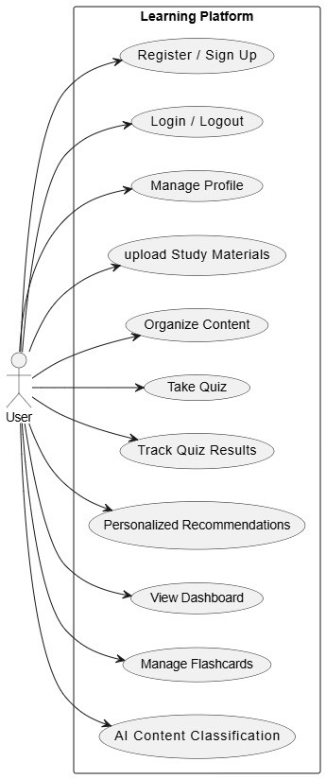
Classification of Learning Speed Using Xgboost Model

Slide 22
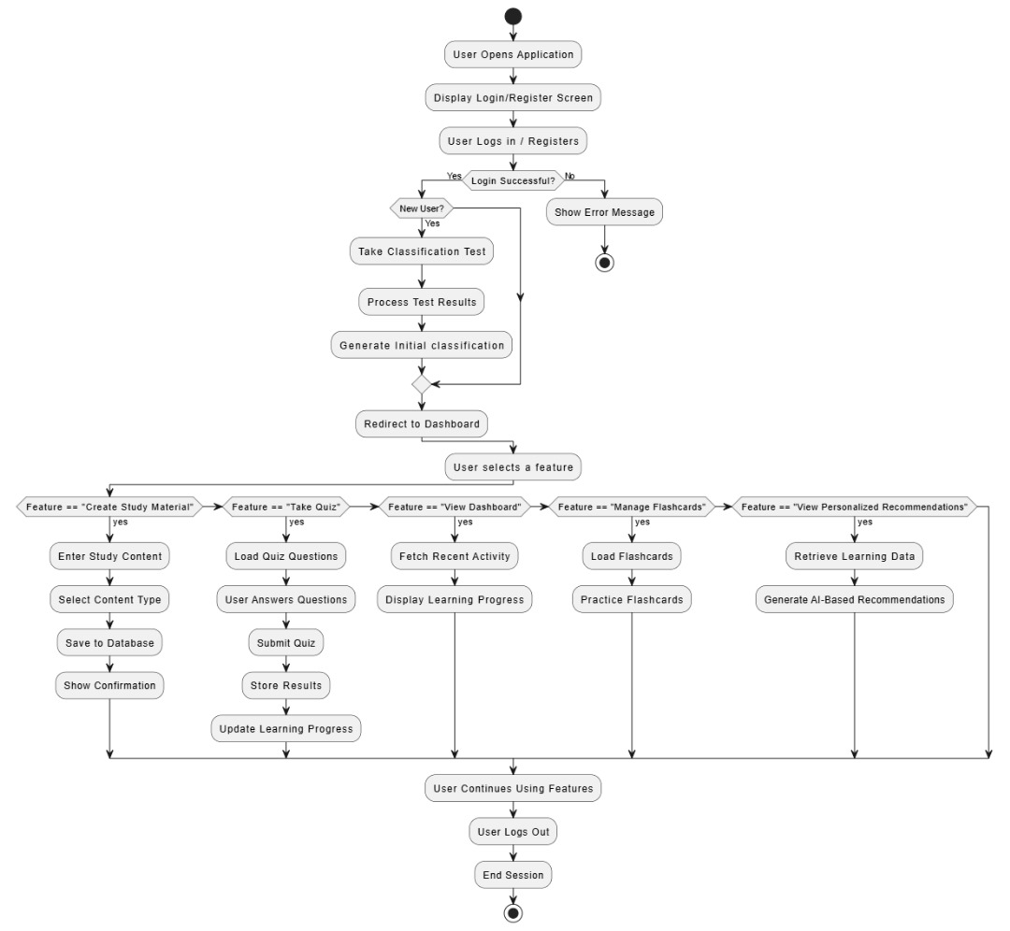
Classification of Learning Speed Using Xgboost Model

Slide 23
07.
Proposed Methodology

Slide 24
Development Approach
Using the extreme programming model for iterative and collaborative development.

Slide 25
Model Integration
For the processing of real-time quiz data, learners’ classification and model deployment, integrating the XGBoost model with Supabase requires supporting tools :
scikit-learn
This machine library complements XGBoost.
It provides preprocessing tools to clean and normalize quiz data before feeding it into the model.
Pandas
This is a tool for data manipulation.
It handles quiz data, time-based metrics, and correctness rates to be used in classification.
Joblib
This tool saves the trained model so that it can be reloaded whenever needed, reducing the computational cost of retraining each time the platform is accessed.

Slide 26




Tools and Technology
React
CSS
For frontend interactivity
For styling
Supabase
Figma
For backend logic
For UI design

Slide 27



Tools and Technology
Machine Learning
Integrated Development Environment
Experimentation
XGBoost
To analyze quiz metrics and classify users into categories (slow, medium, or fast learners)
Visual Studio Code
To manage both frontend and backend code in this project.
Jupyter Notebook
To analyze quiz metrics and classify users into categories (slow, medium, or fast learners).

Slide 28
08..
Results

Slide 29
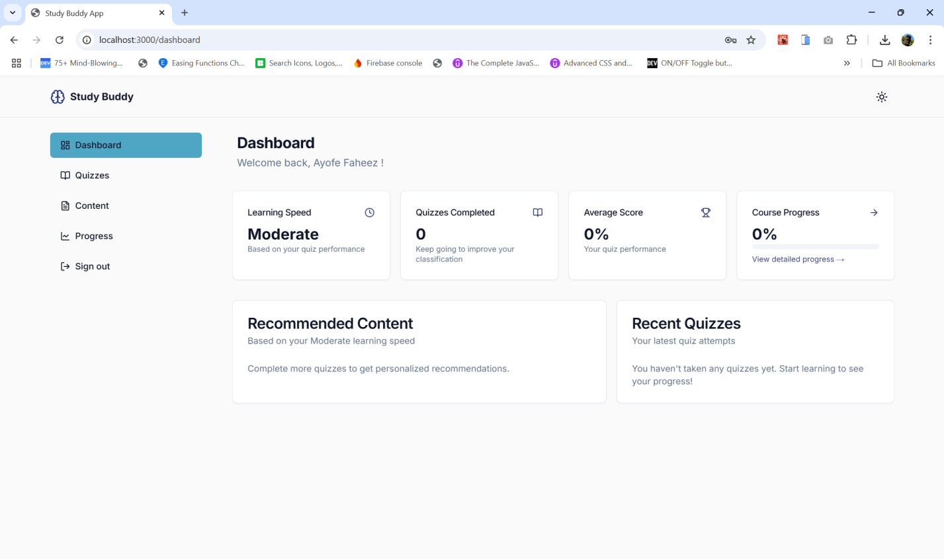
The AI model successfully classified students as fast, medium, or slow learners

Slide 30
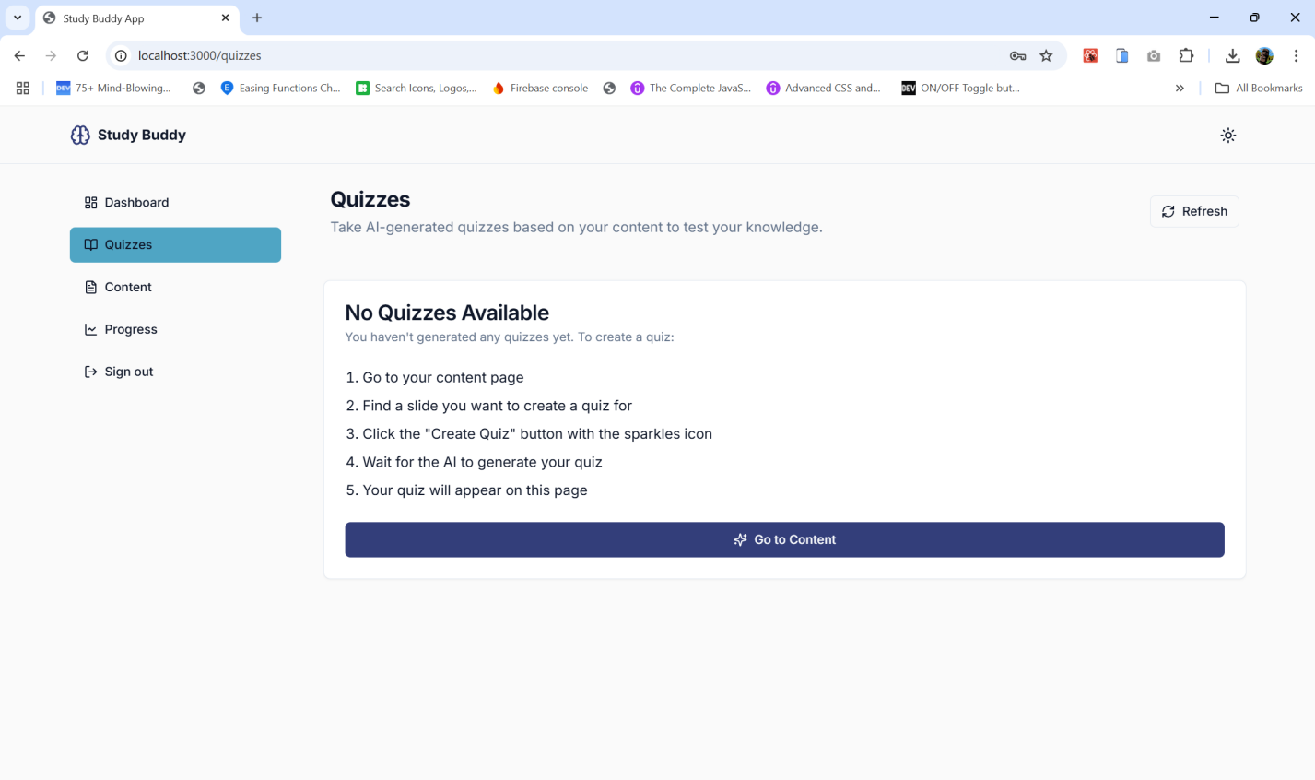
Quiz performance, engagement, and time spent on lessons determined classification accuracy

Slide 31
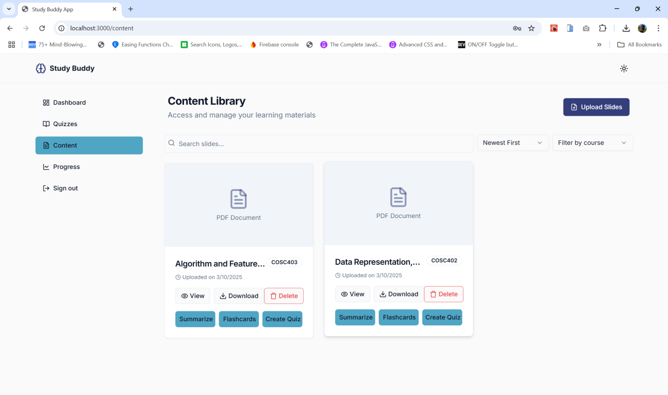
Content Library enables uploads of material and creation of summaries, flashcards and quizzes.

Slide 32
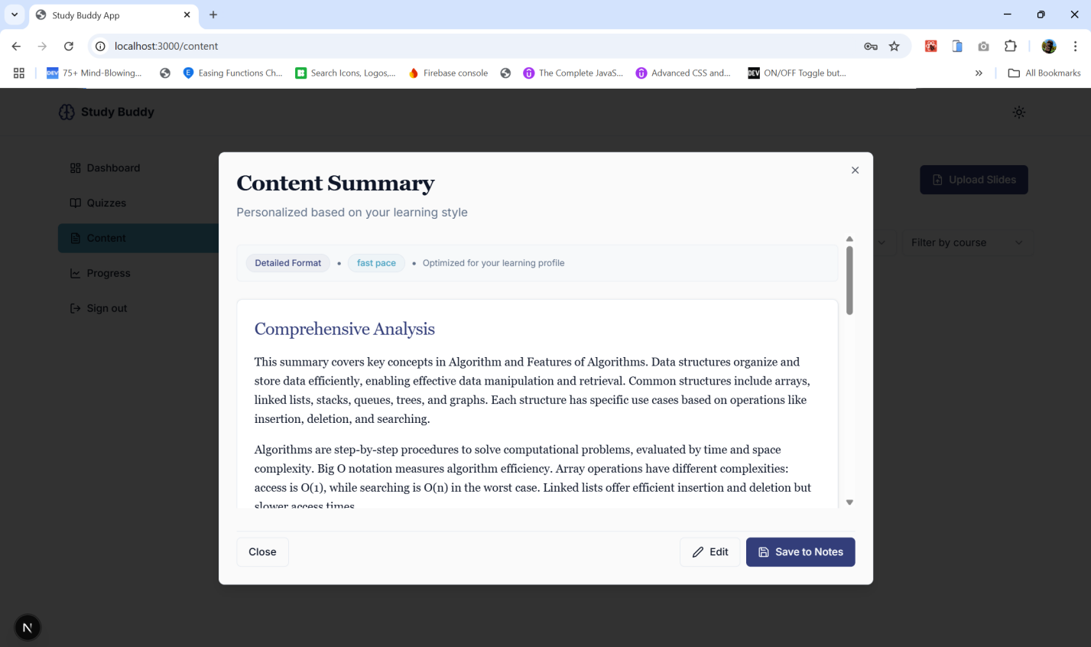
Summarization working from an opened lesson document on a fast learner’s account

Slide 33
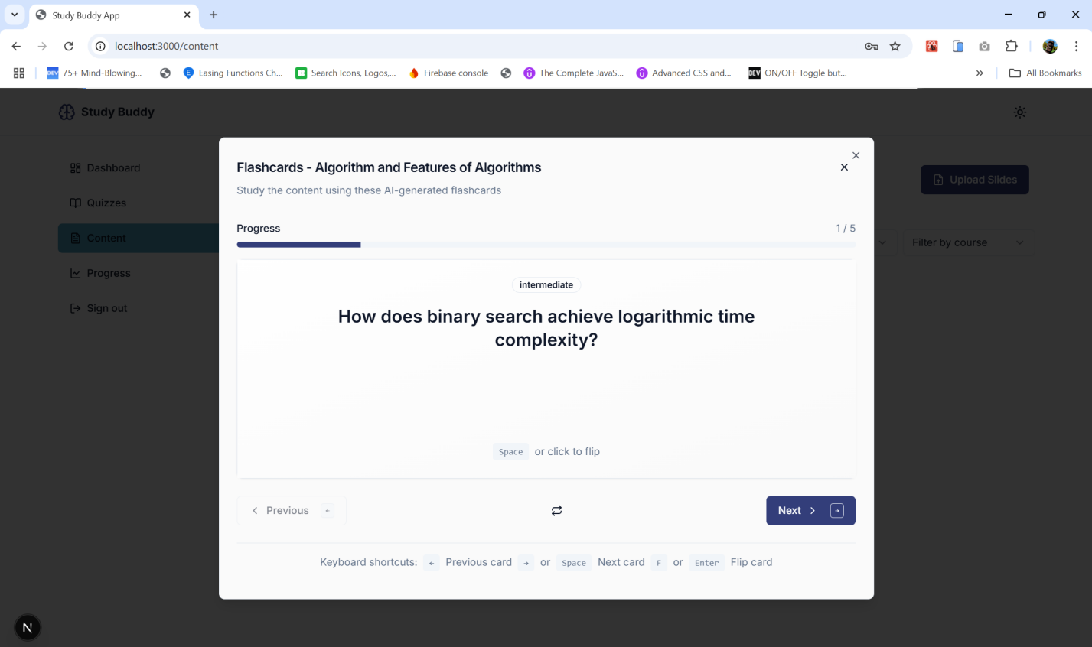
Flashcards working from an opened lesson document

Slide 34
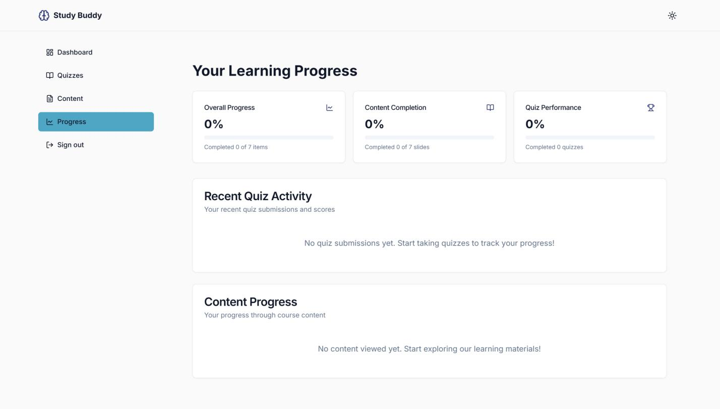
Progress Updates in lesson and quiz completion for performance tracking

Slide 35
Performance Evaluation
Accuracy of XGBoost classification: 89%.
Engagement increase: 40% improvement in quiz participation.
Retention improvement: 30% increase in lesson completion rates.

Slide 36
09..
Conclusion

Slide 37
CONCLUSION
Project Significance: This project lays the groundwork for thorough personalization in electronic/online learning in the digital era.
It demonstrates the potential for skyrocketing the overall effectiveness of learning by incorporating XGBoost-based machine learning for learning speed classification and using a tailored approach that meets the diverse needs of students.
Benefit of XGBoost: The high scalability and accuracy Extreme Gradient Boosting or XGBoost makes it ideal for the purposes of learning speed classification and real-time adjustments to content based on user needs.

Slide 38
10..
Recommendations

Slide 39
Recommendation
Future research on hybrid AI models (e.g., XGBoost + Deep Learning).

Slide 40
11..
References

Slide 41
References
Kim, S., Lee, J., & Choi, K. (2023). The Role of Artificial Intelligence in Personalized Education.
Alsulami, A. A., AL-Malaise, A. S., & Ragab, M. (2023). Enhancement of E-Learning Student's Performance Based on Ensemble Techniques.
Muhammad, B. A., Qi, C., Wu, Z., & Ahmad, H. K. (2024). Enhancing E-Learning Adaptability with Automated Learning Style Identification.
Lee, N. T., & Kim, S. J. (2024). Improving Adaptive Learning Systems with Machine Learning Techniques.
Gupta, R. K., & Zhao, L. H. (2023). The Impact of Personalized Learning on Student Success.

Slide 42
12..
Appreciation

Slide 43
Special thanks to:
Supervisor: Mrs. Fatade Sisboye for guidance.
Babcock University, Department of Computer Science.
Friends & family for their support.
Project team members for dedication and collaboration.

Slide 44
Thank
You!

